Slide 1
Al-Farabi Kazakh National University
Higher School of Medicine
Transcription of genetic information and mRNA processing.
Lecturer: PhD Pinsky Ilya Vladimirovich

Slide 2
LEARNING OUTCOMES
As a result of the lesson you will be able to:
1. Define the terms: transcription, promoter, enhancer, terminator.
2. Describe prokaryotic and eukaryotic RNA-polymerases' structure and functions.
3. Describe phases of transcription, explain the processes happening at each phase and their importance.
4. Explain the process, importance and difference of Rho-independent and Rho-dependent termination of transcription.
5. Explain the mechanism of polyadenylation, its importance.
6. Describe the structure of the cap fragment, its synthesis and functions.
7. Describe the splicing mechanism and its meaning.
8. Explain the effect of splicing on gene expression.

Slide 3
Literature
Alberts et al., pp. 299-333;
Russell, pp. 81-102.

Slide 4
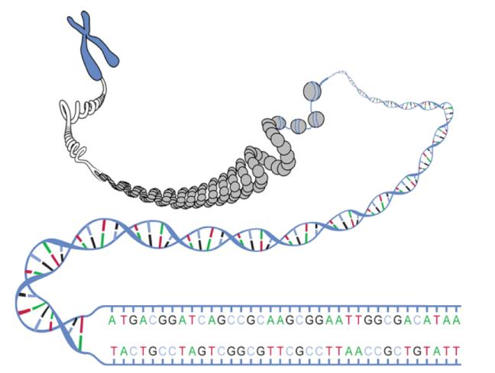
Human chromosomes: 50->250 million base pairs.
Average gene: 3000 base pairs.
<5% of DNA codes for protein.
How to find the genes?.
Source: http://commons.wikimedia.org/wiki/Image:DNA_ORF.gif
4

Slide 5
What is a Gene?
Short stretch of DNA on chromosome.
Two parts:
Regulatory
region
Coding
region
DNA
Information in genes used to make proteins.
Two stages: transcription and translation
5

Slide 6
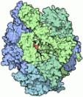

Transcription
Regulatory region has a binding site for RNA polymerase.
RNA Polymerase
Promoter
Terminator
Gene Coding Region
copy of coding region
messenger RNA (mRNA)
DNA: http://commons.wikimedia.org/wiki/File:Helix84.JPG
RNA Polymerase: http://commons.wikimedia.org/wiki/File:PDB_1sfo_EBI.jpg
RNA: http://commons.wikimedia.org/wiki/File:Simple_transcription_termination1.svg
6

Slide 7
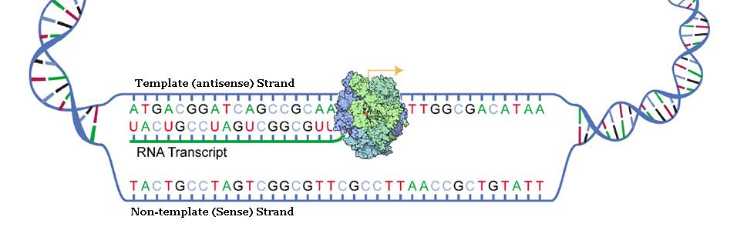
Transcription
Similar to DNA replication, but different.
Copies only one of the two strands.
Makes a copy as RNA, not DNA.
Source: http://commons.wikimedia.org/wiki/File:DNA_transcription.svg

Slide 8
Gene expression
DNA - RNA - Protein
DNA
DNA
RNA
Protein
Replication
Initiation
Elongation
Processing
Export
Transcription
Degradation
Translation
Initiation
Elongation
Processing
Targeting
Degradation

Slide 9
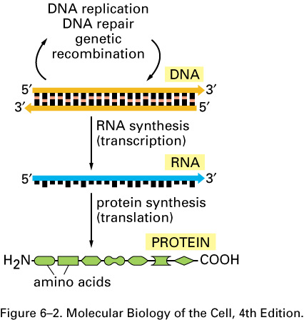

Slide 10
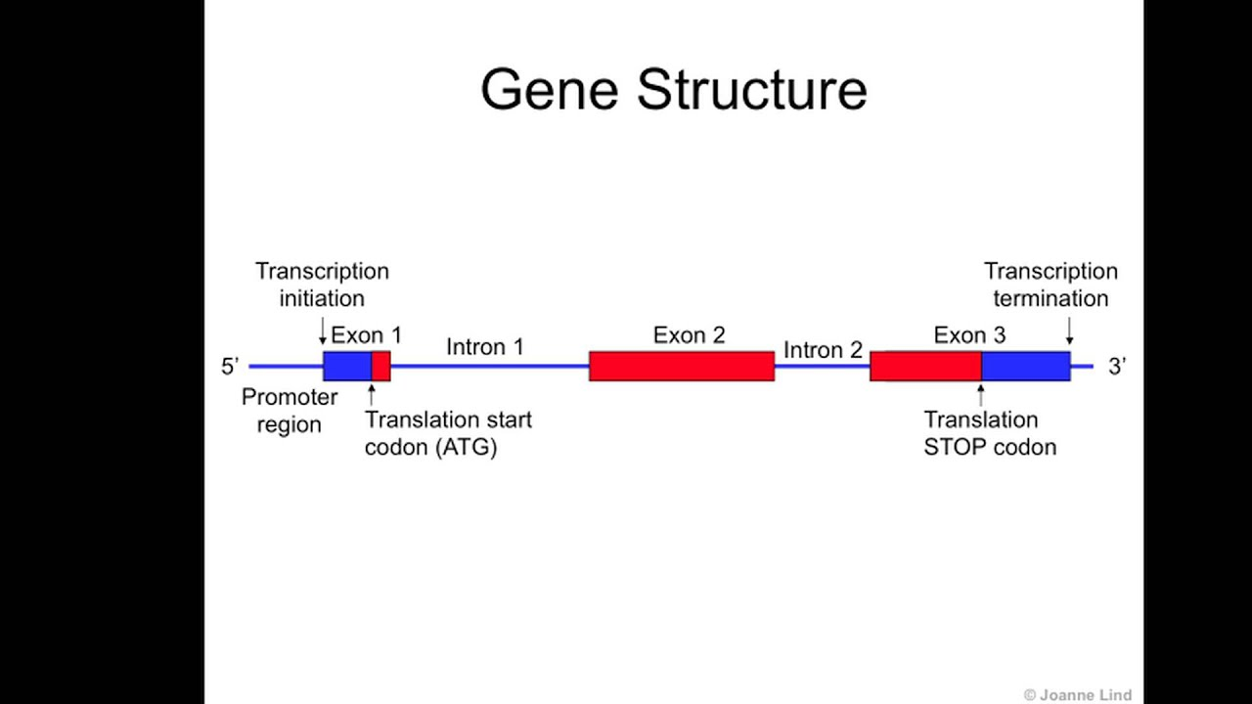

Slide 11
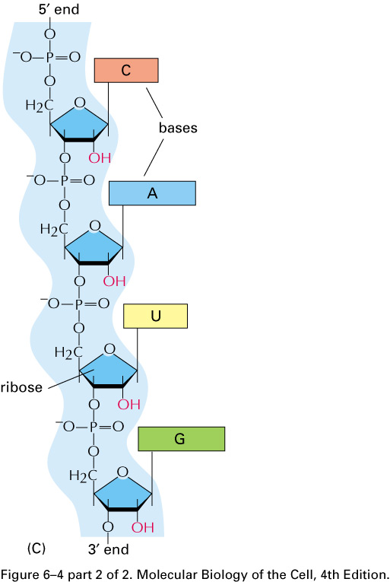
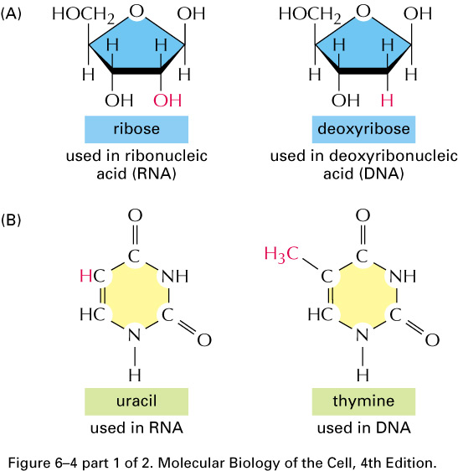

Slide 12
RNA structure
RNA is single stranded polymer of C, G, A, U
Can have secondary structure but typically not a double helix

Slide 13
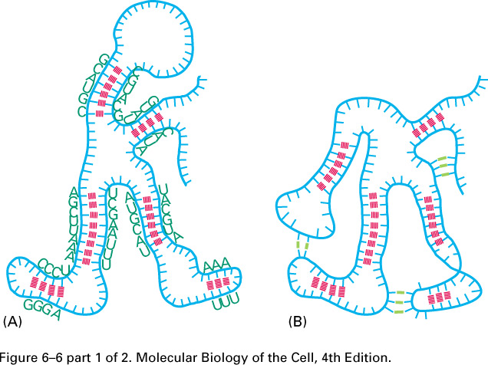
Secondary structures of mRNA

Slide 14
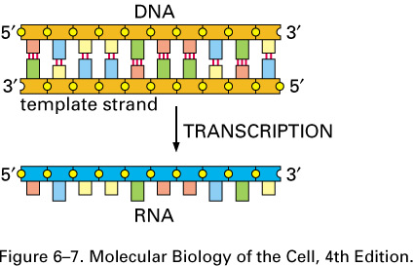

Slide 15
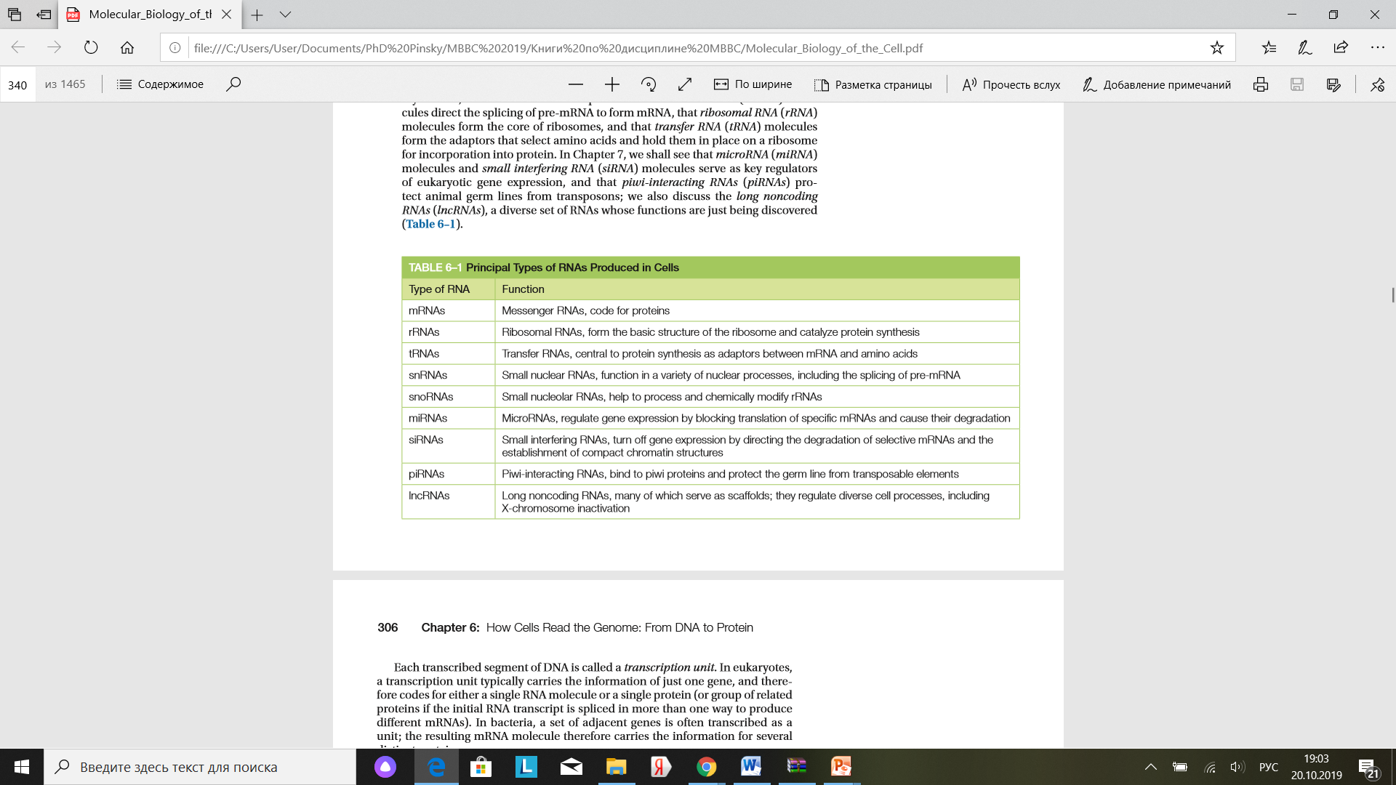

Slide 16
Types of RNA-polymerases
DNA acts as a template for RNA synthesis
Synthesis by RNA polymerase -RNA Pol
RNA Pol I makes 28S, 18S, and 5,8S rRNA
RNA Pol II makes mRNA, miRNAs and snRNAs in nucleus
RNA Pol III makes tRNA and other small RNAs

Slide 17
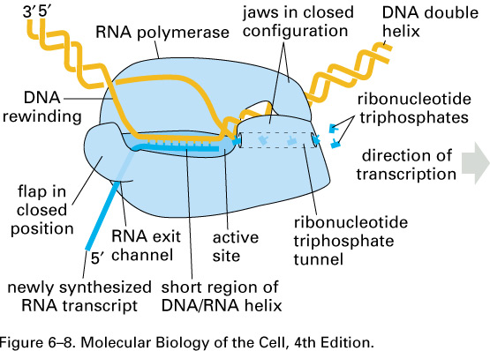

Slide 18
Control of transcription
Transcription initiation by RNA Pol II requires general transcription factors

Slide 19
Control of transcription
Transcription start site usually a TATA box (not always)
TBP (TATA-binding protein) binds, changing DNA structure.
Recruits transcription factor II proteins (TFIIA, B, …) then RNA Pol II
Collectively the transcription initiation complex

Slide 20
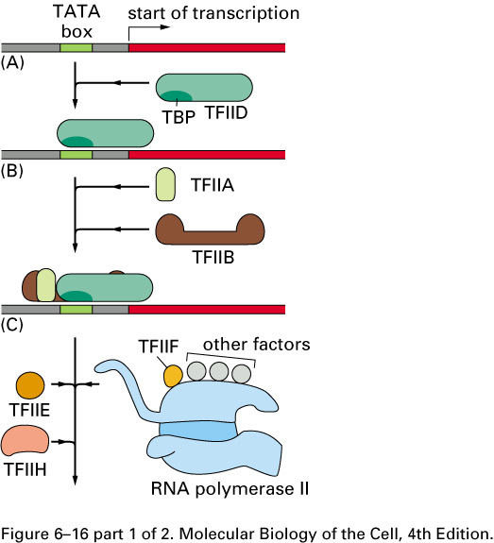
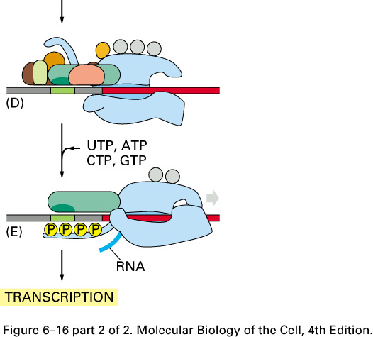

Slide 21
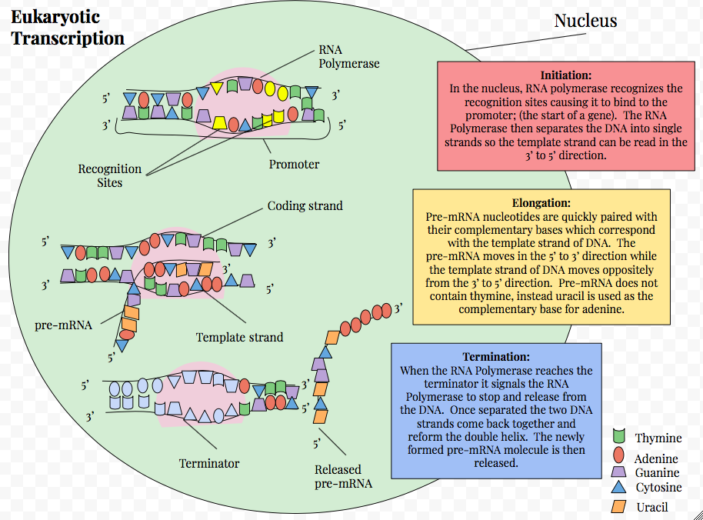

Slide 22
Control of transcription
Since DNA is wrapped around histones, how does RNA Pol gain access to the promoter?
How does RNA Pol know where to bind?

Slide 23
Control of transcription
Transcription initiation also requires:
  activators
  mediators (or co-activators),
  chromatin-remodeling proteins
Activators increase the likelihood of successful transcription initiation
Mediators allow activators to communicate with RNA Pol II

Slide 24
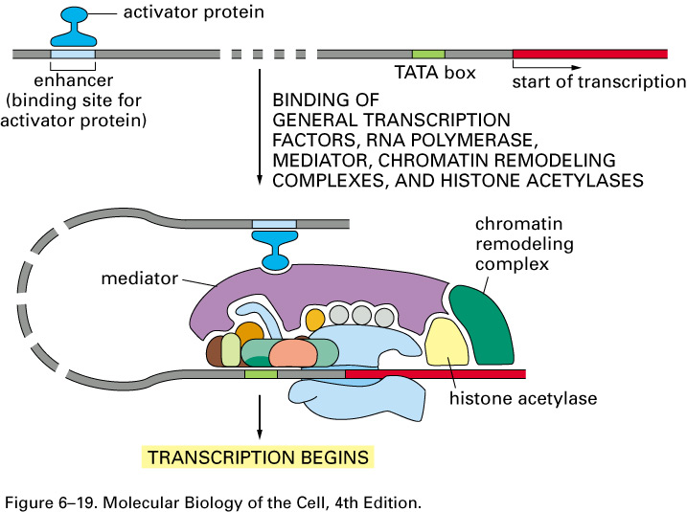

Slide 25
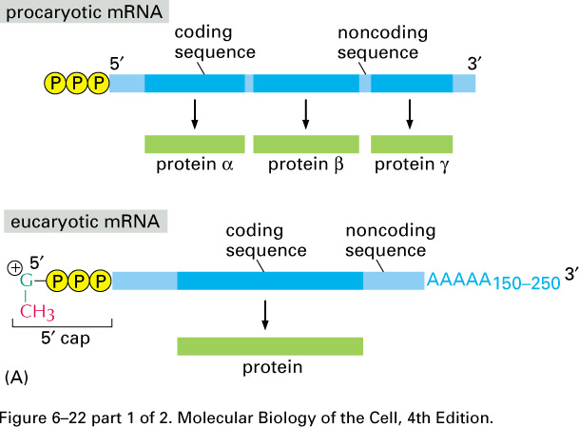

Slide 26
Transcription factors
DNA-binding proteins associate with specific regions on DNA (elements)
Elements may be as small as 6 nucleotides
Subtle differences in DNA 3 dimensional structure alter the ability of proteins to bind

Slide 27
RNA processing
Newly synthesized transcripts (mRNA) are processed:
Splice out intervening sequences (=introns) leaving expressed sequences (exons)
“Cap” 5’ end of RNA
Poly-adenylate 3’ end (Poly A⁺ tail)

Slide 28
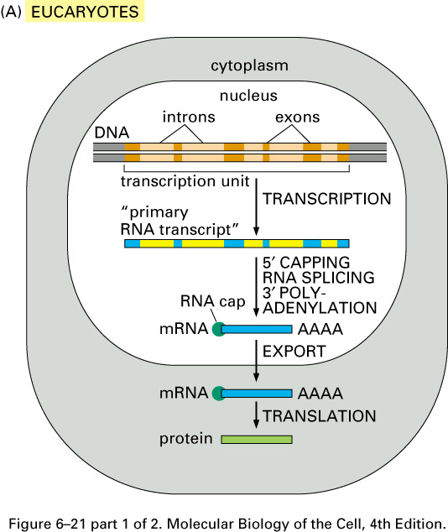

Slide 29
The CALCA gene
Poly “A” sites
5´--
Calcitonin exon
CGRP exon
--3´
1
2
3
4
5
6
Key features:
6 expressed sequences, or exons
  Exon 4 codes for 32 amino acids to form calcitonin
  Exon 5 codes for 37 amino acids to form CGRP
Two polyadenylation, or poly-A sites, recognized by enzymes that can facilitate cleavage and poly-A addition at the 3´ end of the corresponding mRNA
Intervening sequences, or introns

Slide 30
A closer look at pre-mRNA processing
Let’s consider this gene with three exons, numbered 1-3:
During and after transcription but before splicing, the pre-mRNA receives two modifications:
DNA
5´--
--3´
1
2
3
RNA
5´--
G
AAAAA…..AAAA--3´
--3´
1
2
3

Slide 31
A closer look at RNA splicing
Now let’s splice to remove introns:
5´--G
AAAAA…..AAAA--3´
1
2
3
x
The spliceosome recognizes sequences at intron/exon boundaries and cuts introns out
………………..……AG
GU……A……AG
G………………………
With both introns removed, our mature mRNA now looks like this:
5´--G
AAAAA…..AAAA--3´
1
2
3

Slide 32
Alternative splicing of the CALCA gene
Poly “A” sites
DNA
5´--
Calcitonin exon
CGRP exon
--3´
1
2
3
4
5
6
Thyroid cells
Neuronal cells
RNA
5´-G
Calcitonin exon
A..A-3´
5´-G
CGRP exon
A..A-3´
1
2
3
4
1
2
3
5
6

Slide 33
Translation and post-translational processing
Poly “A” sites
DNA
5´--
Calcitonin exon
CGRP exon
--3´
1
2
3
4
5
6
Thyroid cells
Neuronal cells
RNA
5´-G
Calcitonin exon
A..A-3´
5´-G
CGRP exon
A..A-3´
1
2
3
4
1
2
3
5
6
(Other peptides corresponding to other translated exons are removed during post-translational processing and not shown here)
Calcitonin (32 amino acids)
CGRP (37 amino acids)
Protein

